Slide 1

Detrap Model Development
& Trap Variation Simulation Method
진명
1/8
School of Electrical Engineering, Seoul National University

Slide 2
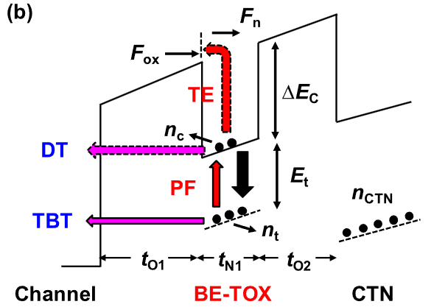
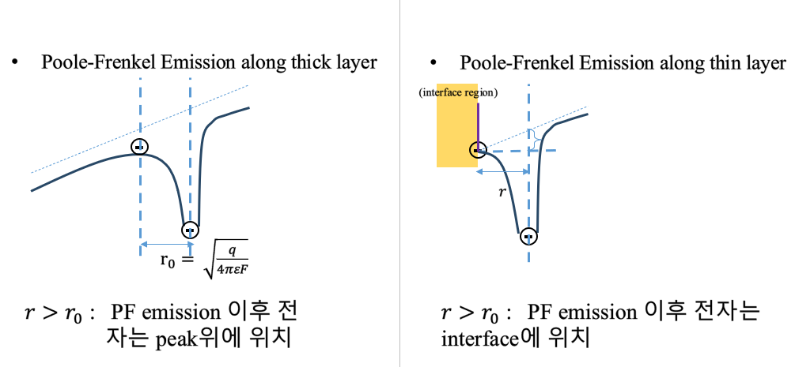

Development Point
Modified Poole-Frenkel emission
Trap variation enabled simulation
>> shaping enabled for the detrap simulation
1. Modified PF emission
2. Trap distribution
2/8
School of Electrical Engineering, Seoul National University

Slide 3

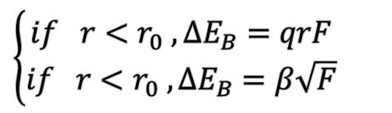
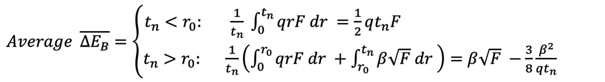
Modified Poole-Frenkel Emission
$⇒F$ : Field
$\left\{\begin{aligned}if r<r_{0} , ΔE_{B}=qrF \\ if r<r_{0} , ΔE_{B}=β\sqrt{F}\end{aligned}\right.$
$Average \overline{ΔE_{B}}=\left\{\begin{aligned}t_{n}<r_{0}: \frac{1}{t_{n}} \int_{0}^{t_{n}}{qrF dr }=\frac{1}{2}qt_{n}F \\ t_{n}>r_{0}: \frac{1}{t_{n}}\left(\int_{0}^{r_{0}}{qrF dr }+\int_{r_{0}}^{t_{n}}{β\sqrt{F} dr} \right)=β\sqrt{F} −\frac{3}{8}\frac{β^{2}}{qt_{n}}\end{aligned}\right.$
As $t_{n}→∞, \overline{ΔE_{B}}→β\sqrt{F}$
3/8
School of Electrical Engineering, Seoul National University

Slide 4
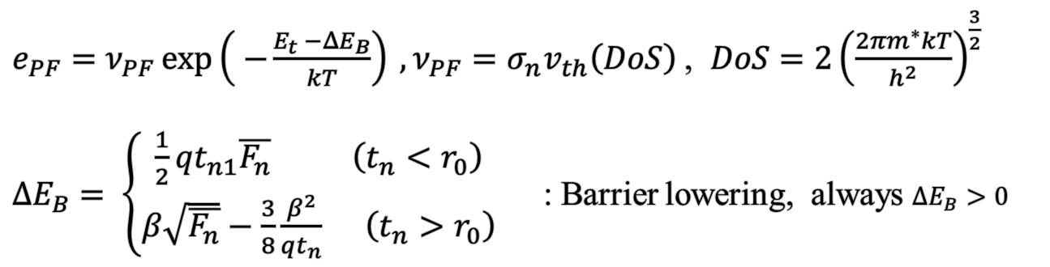
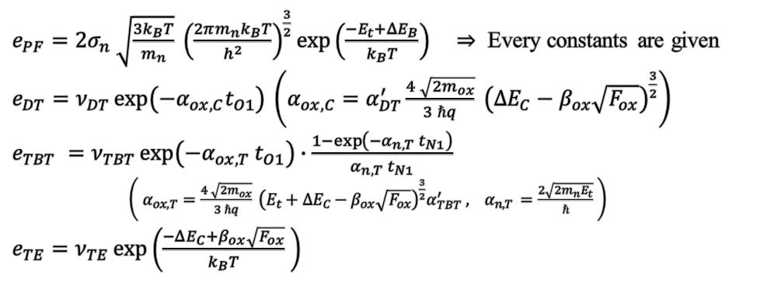
Modified Poole-Frenkel Emission
Modified Poole-Frenkel Emission in thin layer
$e_{PF}=ν_{PF}\exp\left( −\frac{E_{t} −{ΔE}_{B}}{kT}\right) , ν_{PF}=σ_{n}v_{th}\left(DoS\right)$, $DoS=2{\left(\frac{2πm^{∗}kT}{h^{2}}\right)}^{\frac{3}{2}}$
${ΔE}_{B}= \left\{\begin{aligned}\frac{1}{2}qt_{n1}\overline{F_{n}} \left(t_{n}<r_{0}\right) \\ β\sqrt{\overline{F_{n}}}−\frac{3}{8}\frac{β^{2}}{qt_{n}} \left(t_{n}>r_{0}\right)\end{aligned} \right.$ : Barrier lowering, always ${ΔE}_{B}>0$
$e_{PF}=2σ_{n} \sqrt{\frac{3k_{B}T}{m_{n}}} {\left(\frac{2πm_{n}k_{B}T}{h^{2}}\right)}^{\frac{3}{2}}\exp\left(\frac{−E_{t}+ΔE_{B}}{k_{B}T}\right) ⇒$ Every constants are given
$e_{DT}=ν_{DT}\exp\left(−α_{ox,C}t_{O1}\right) \left(α_{ox,C}=α_{DT}^{′}\frac{4 \sqrt{2m_{ox}}}{3 ℏq} {\left(ΔE_{C}−β_{ox}\sqrt{F_{ox}}\right)}^{\frac{3}{2}}\right)$
$e_{TBT} =ν_{TBT}\exp\left(−α_{ox,T} t_{O1}\right)∙\frac{1−\exp\left(−α_{n,T} t_{N1}\right)}{α_{n,T} t_{N1}}$
$\left( α_{ox,T}=\frac{4 \sqrt{2m_{ox}}}{3 ℏq} {\left(E_{t}+ΔE_{C}−β_{ox}\sqrt{F_{ox}}\right)}^{\frac{3}{2}}α_{TBT}^{′} , { α}_{n,T }=\frac{2\sqrt{2m_{n}E_{t}}}{ℏ} \right)$
$e_{TE}=ν_{TE}\exp\left(\frac{−ΔE_{C}+β_{ox}\sqrt{F_{ox}}}{k_{B}T} \right)$
Final model :
20240705 수정
4/8
School of Electrical Engineering, Seoul National University

Slide 5
Trap Level Dependency
Trap level variation
지난 자료에서…
해당 모델은 stretched exponential 형태에서 shape parameter β에는 영향을 주지 못하고, 오직 τ값에 fitting이 목적임.
Resolution
Trap distribution enabled simulation
>> Main idea: summation of discrete trap level
5/8
School of Electrical Engineering, Seoul National University

Slide 6
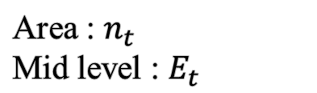
Trap Variation Enabled Simulation
Method : Trap distribution input – Trap concentration
Area : $n_{t}$
Mid level : $E_{t}$
Resolution = 10
Resolution = 100
Resolution
…
Resolution = 20
Trap profile resolution ~ simulation time : trade-off
6/8
School of Electrical Engineering, Seoul National University

Slide 7
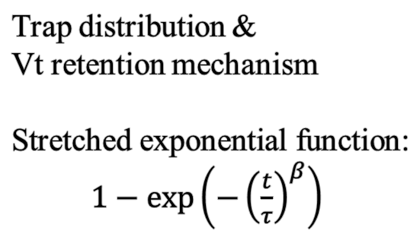

Result Fitting in Gaussian as Shaping
Trap distribution &
Vt retention mechanism
Stretched exponential function:
$1−\exp\left(−{\left(\frac{t}{τ}\right)}^{β}\right)$
$$β<1 as σ↑$$
Arbitrary distribution
7/8
School of Electrical Engineering, Seoul National University

Slide 8
Future Works
Retention Mechanism 별로 (TBT, PF 등) dominancy에 대한 고찰 (Calibration이 앞서야 해당 특성 관찰 가능)
연구실 소자의 Gaussian 분포 활용하여 TCAD calibration 진행
Barrier lowering에 대한 주요사항 고려 – PV level dependency
8/8
School of Electrical Engineering, Seoul National University

